Slide 1
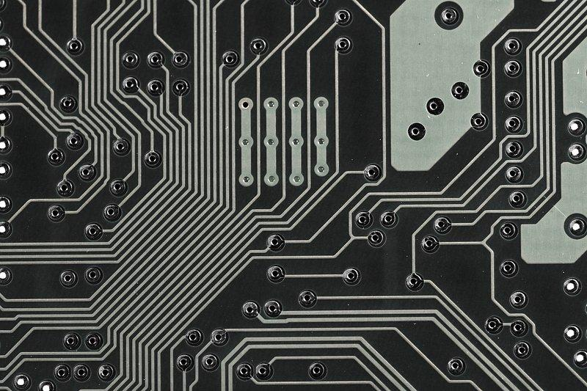
Pythagoras
Robotic Car Project
7/29/25

Slide 2
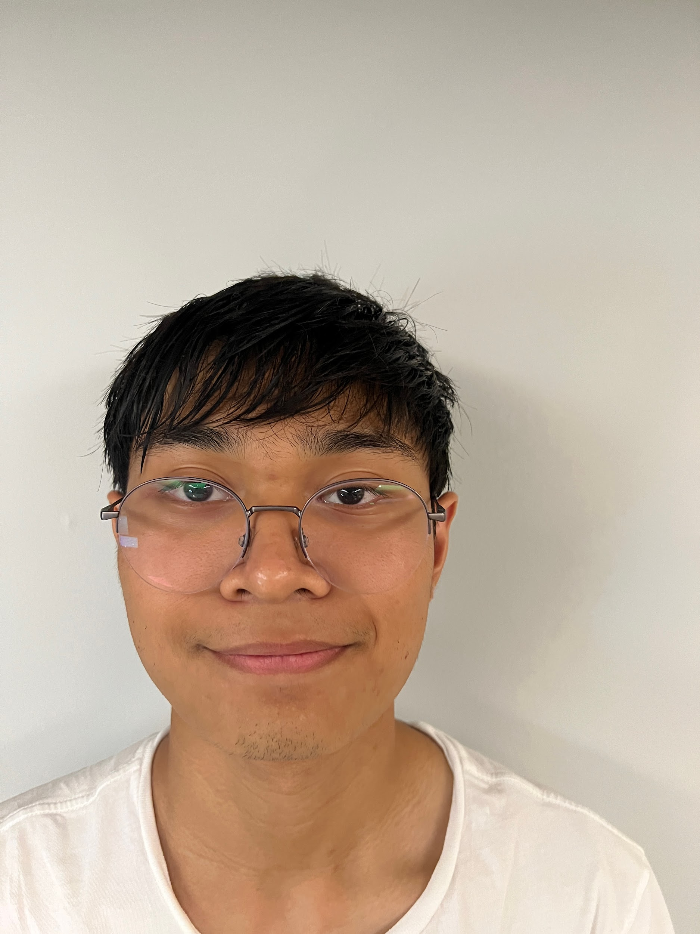
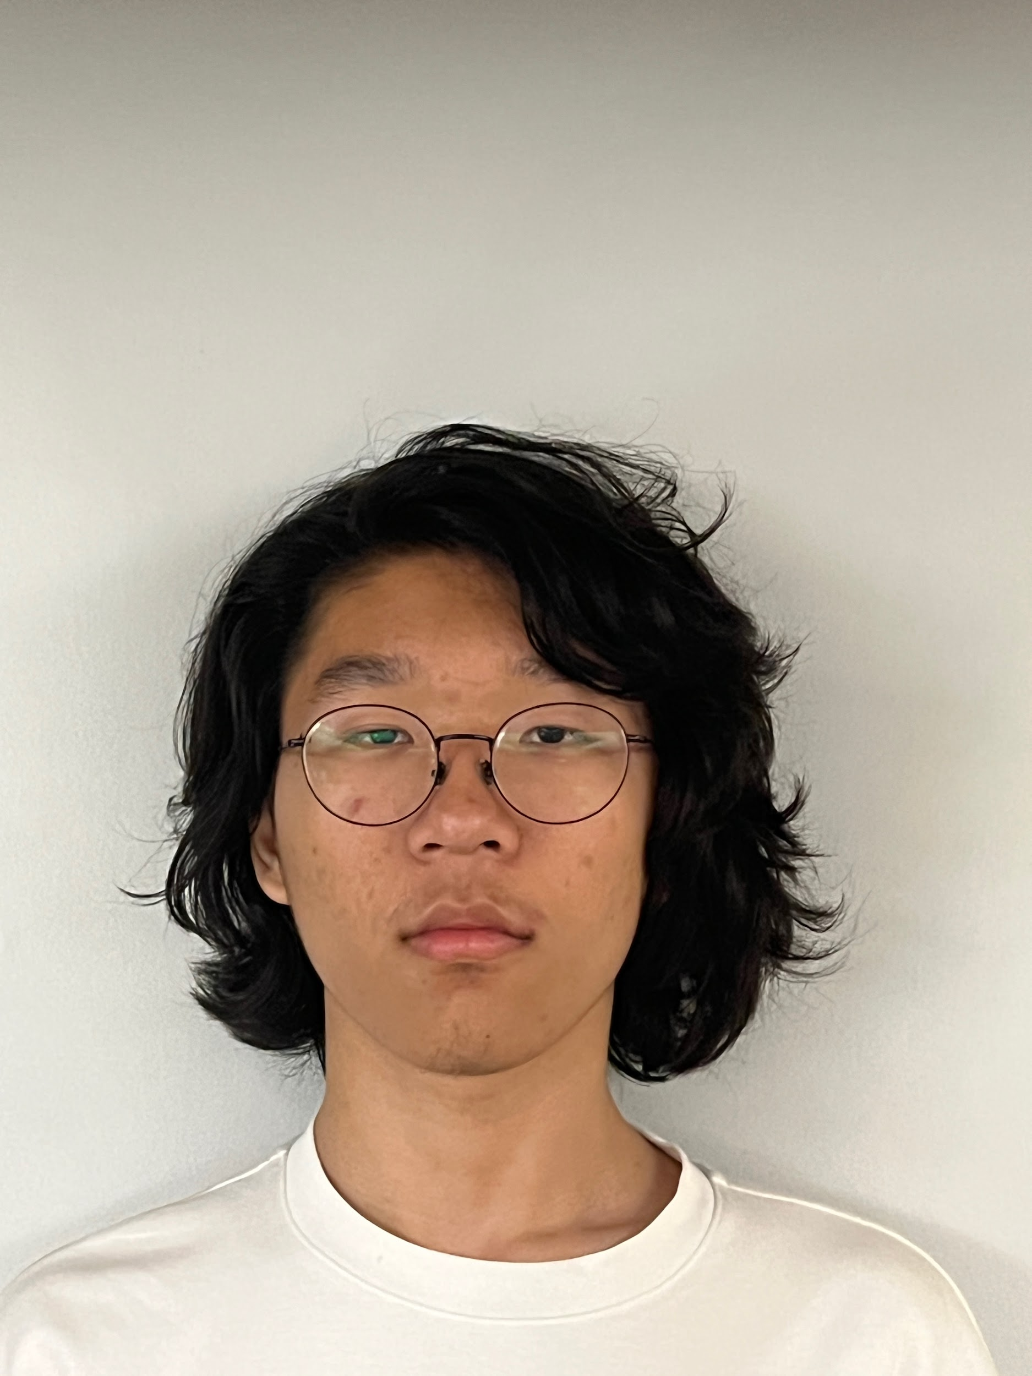
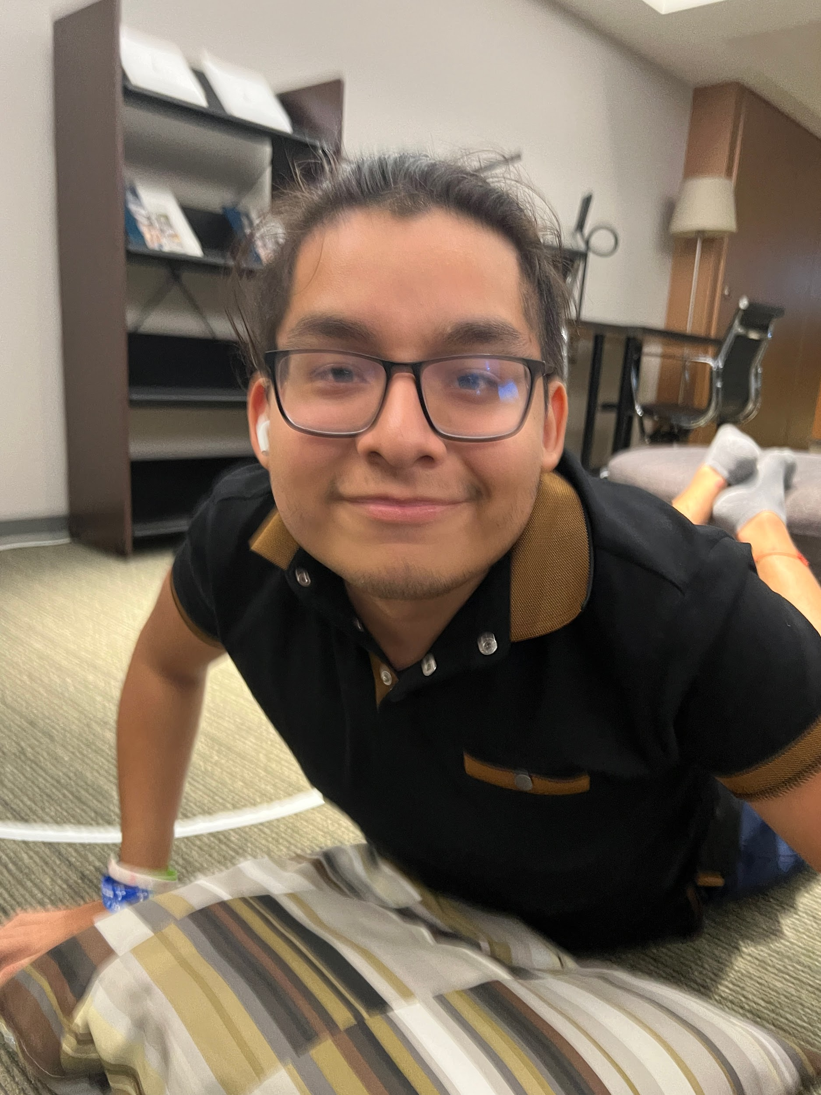
Team
Larsen Mathew L.
Age: 17
“I am Larsen Matthew Libinius.”
Erick Zheng
Age: 17
“My life is a story of pain and raspberry pi is its scribe.”
Renato Perochena
Age: 17
“It feels great to be a father.”

Slide 3
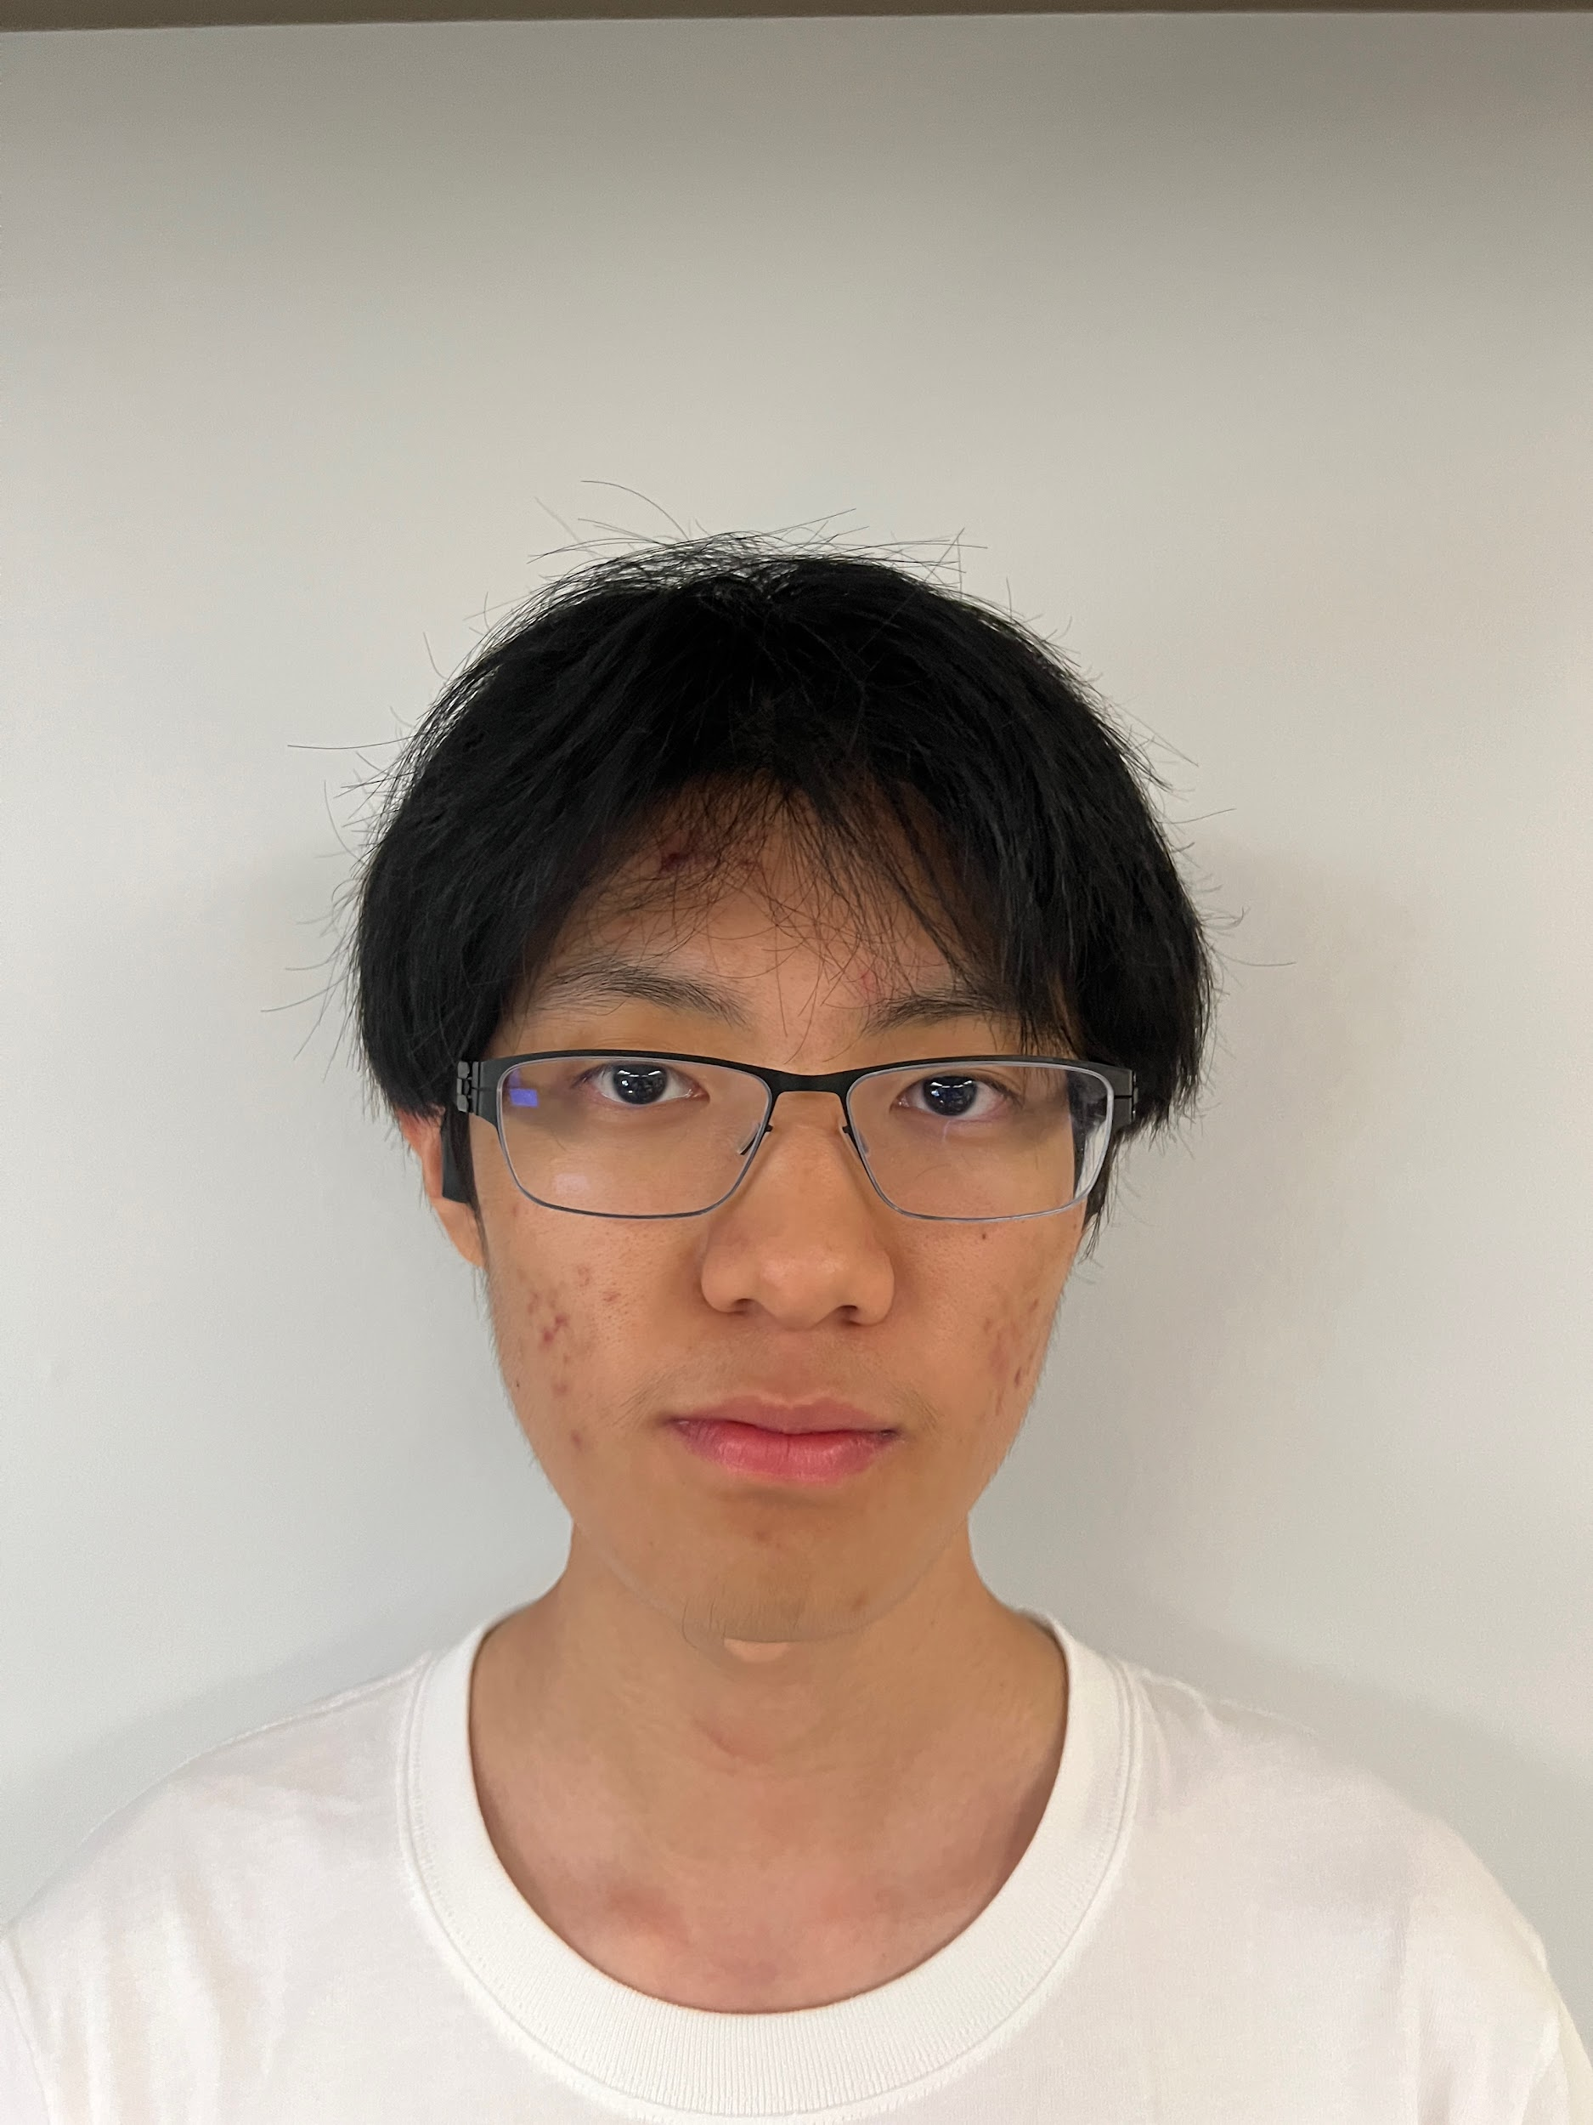
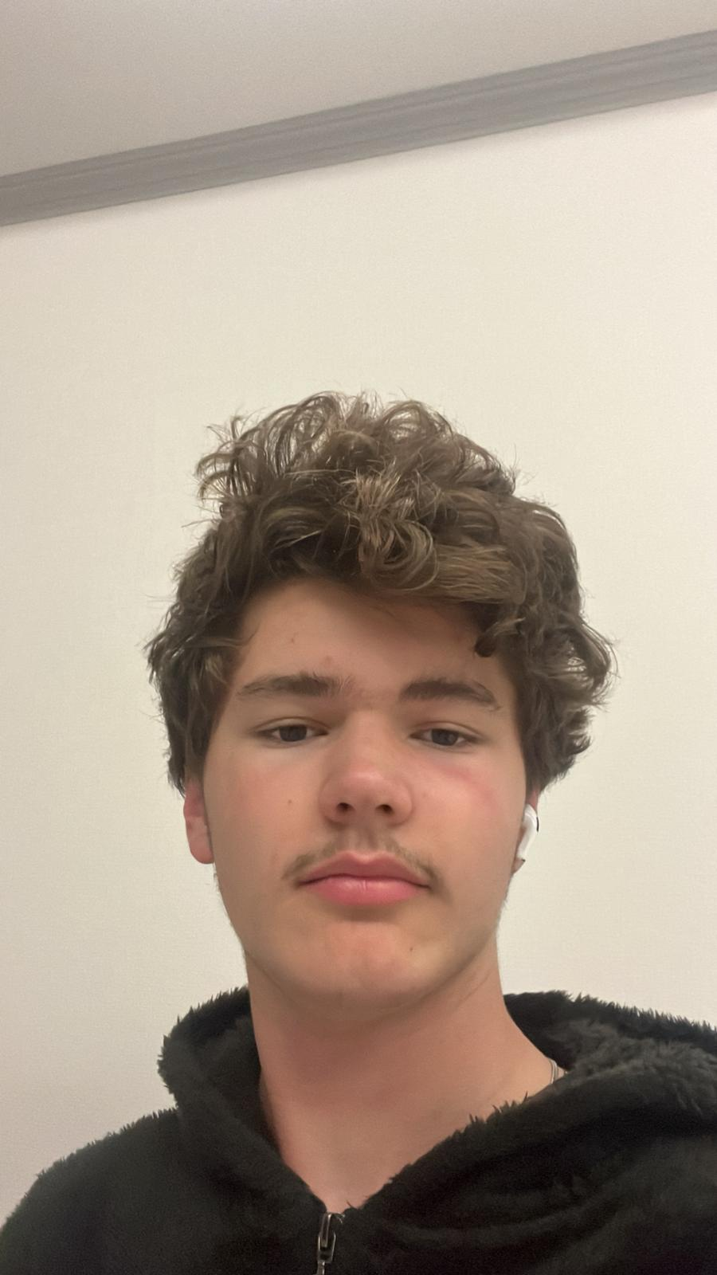
Team
Ted Wong
Age: 16
“One man’s trash is another man’s trash.”
Nate Raunhoust
Age: 15
“Hey guys.”

Slide 4
Task Planning
Ted
IR Sensor
Photoresistor
Ultrasonic
Presentation
Erick
Color Detection
Camera
Servos
Ultrasonic
Renato
IR Sensor
Debugger
MPU
Compiler
Larsen/Matt
IR Sensor
Load Sensor
Debugger
GitHub
Nate
Color Detection
Camera
Construction
Debugger

Slide 5
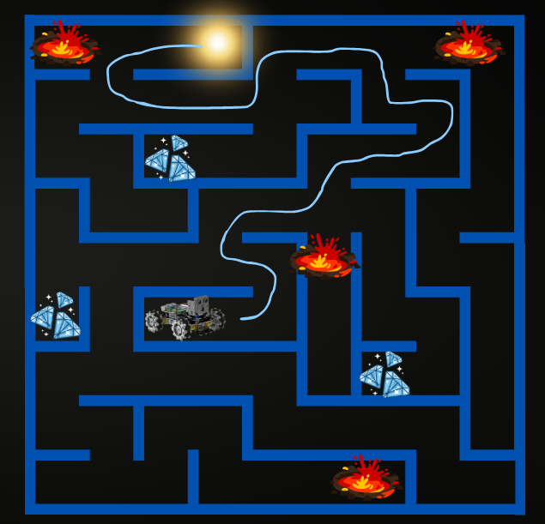
Abstract/Problem
Autonomous Navigation
Obstacle Avoidance
Object Recognition
Timed Constraint

Slide 6
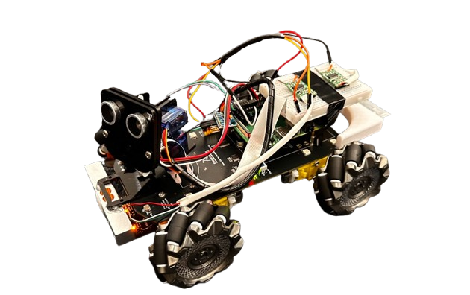
Solution
Wheels/Motors
Raspberry pi
Motors
Camera
Photoresistors
Ultrasonic Sensors
Load sensors

Slide 7
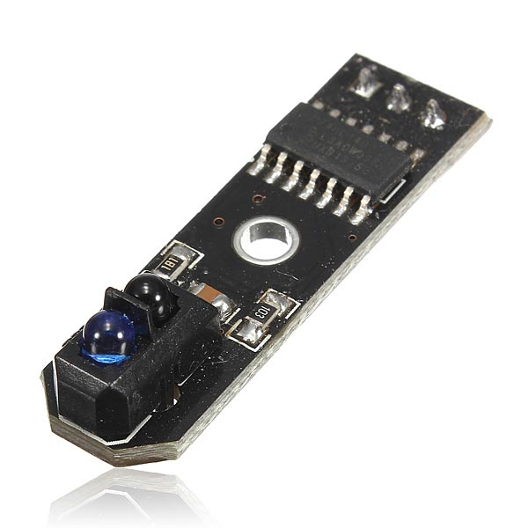
IR Sensor
Detects Infrared Reflection
True/False
Follows Path

Slide 8
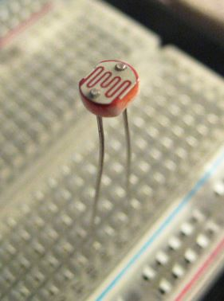
Photoresistor
Light Sensor
Records Voltage

Slide 9
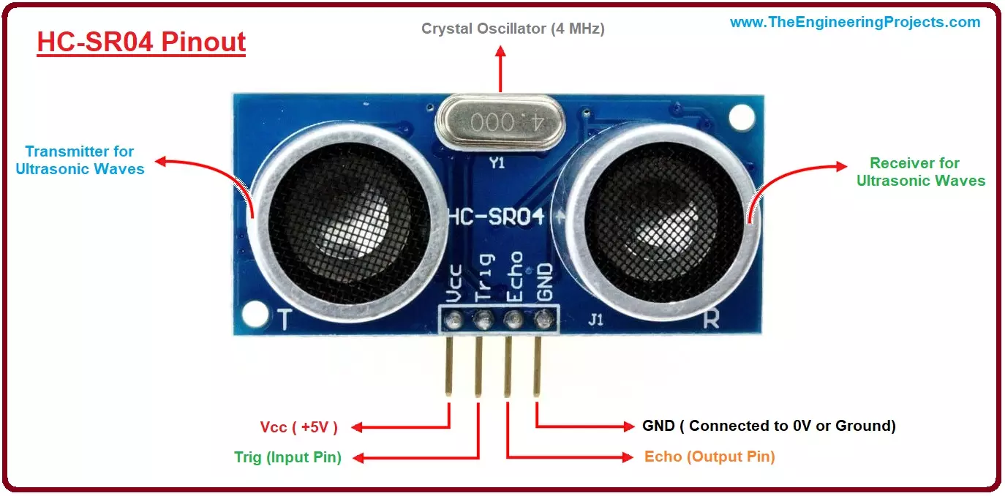
Ultrasonic Sensors
Sound waves
Distance
(cm)

Slide 10
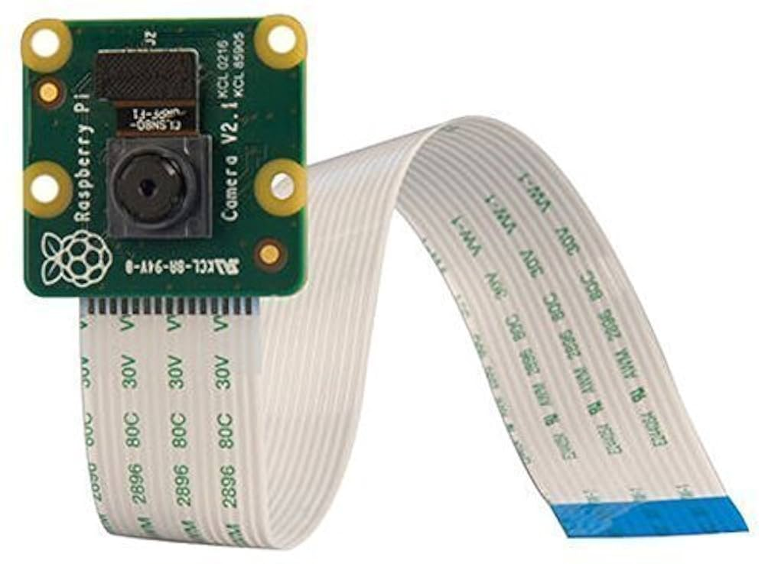
Camera
OpenCV
Manipulation of Image Files
Color Detection

Slide 11
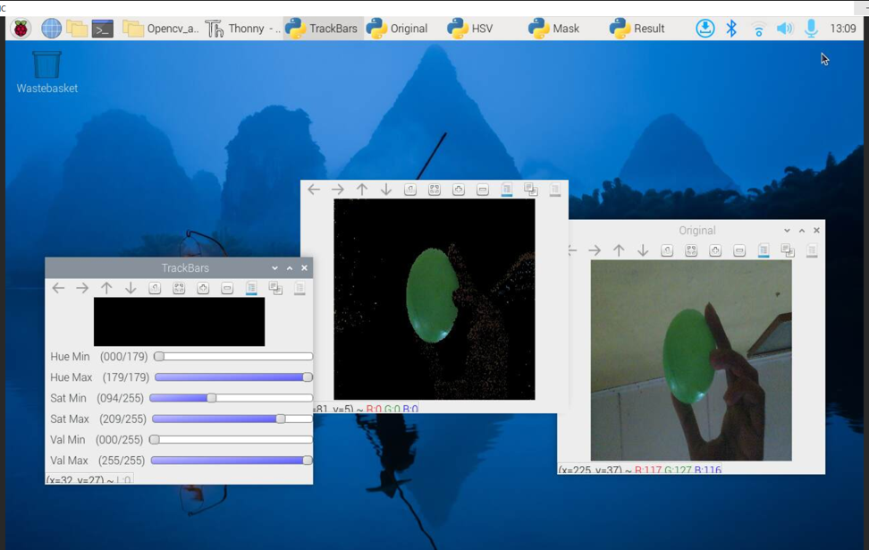
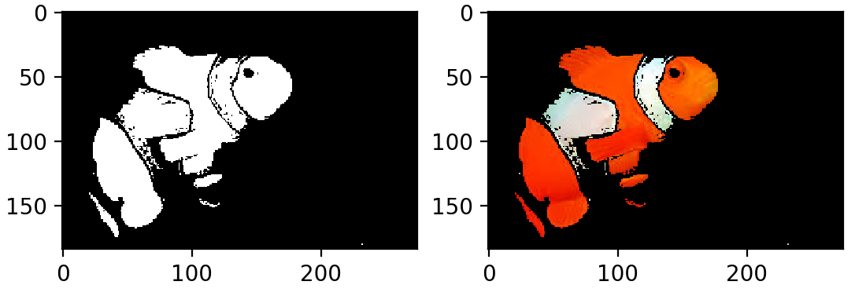
OpenCV

Slide 12
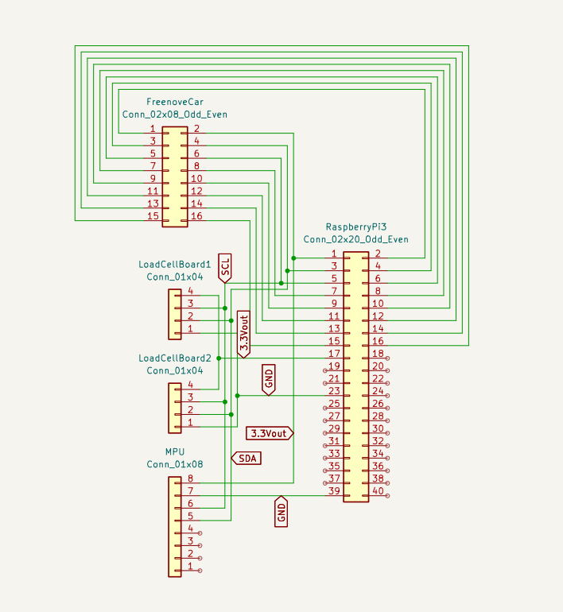
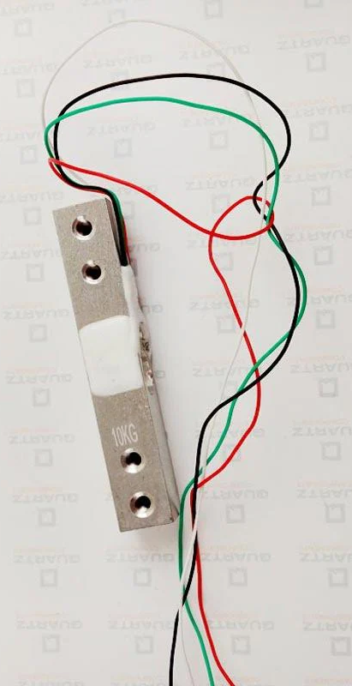
Load Cells
Detects force
(20 kg)
Hardware
Variant I2C

Slide 13
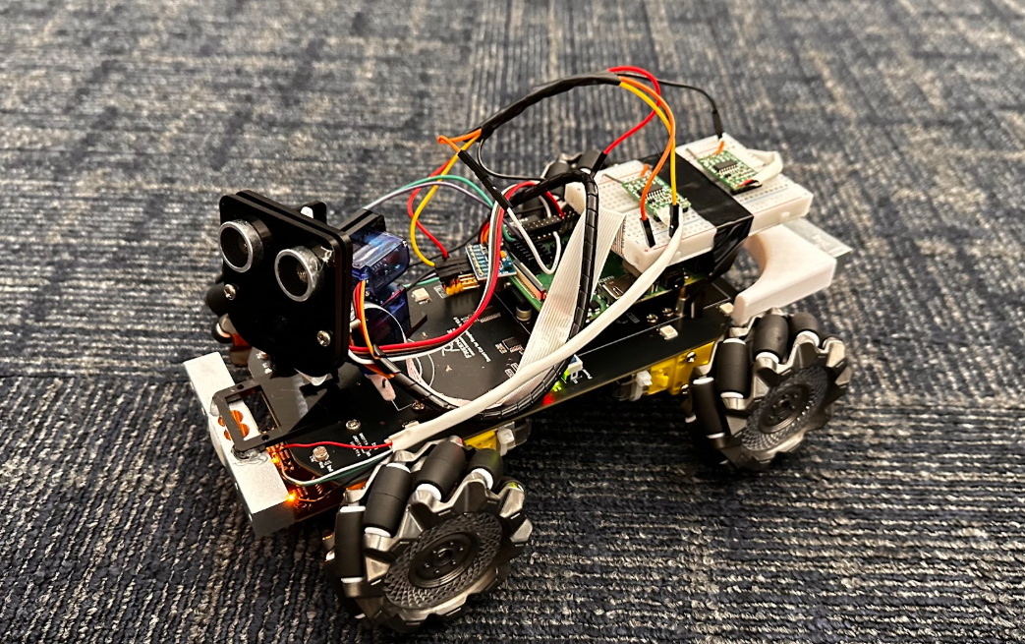
Demonstration

Slide 14
Issues Encountered
Minor
Undefined movement functions
Pi Overloading
Soldering
Color Detection
Major
IR sensor logic
Turtle/localization
Servos

Slide 15

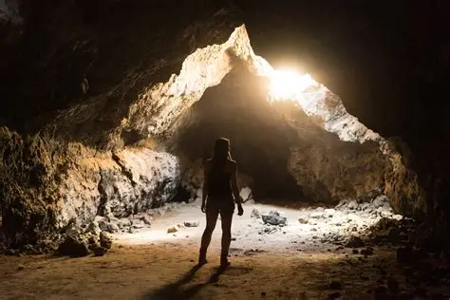
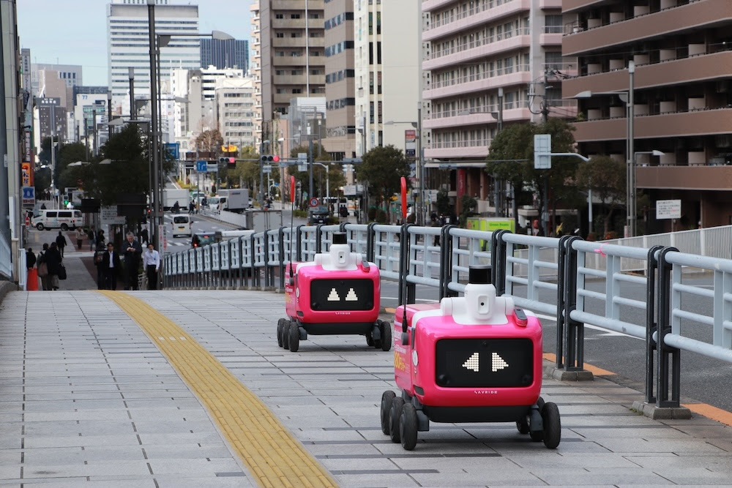

Conclusion
Complex Robotic Concepts
Better Coordination
Lots of Enjoyment

Slide 16
Q&A

